Slide 1
Al-Powered Sign Language Translator Create an Al-based real-time sign language- to-text and speech converter to bridge communication gaps for the hearing-impaired community.
Bugs Slayers
PROBLEMS 10
Healthcare & Biotech
(SDG 10: Reduced
Inequalities)
K Jaya Sravani 12212274
K Sivaram 12220696
Arvind Choudhary 12214090
Aman Choudhary 12214092

Slide 2
Problem Statement: Communication Barriers for the Hearing-Impaired Community: Communication is one of the most fundamental aspects of human interaction. However, for individuals with hearing impairments, interacting with those who don't know sign language can be extremely challenging. This barrier can lead to isolation, misunderstanding, and difficulty accessing services, education, and opportunities. For instance, in public spaces or educational institutions, hearing-impaired individuals often face difficulties communicating effectively without assistance. In addition, sign language interpreters may not always be available.
Why This Solution Matters:
Real-Time System to Bridge the Communication Gap: To address this issue, we have developed an AI-powered real-time sign language recognition system. This solution aims to make communication between hearing-impaired individuals and those who don't know sign language much more accessible.
By using real-time hand tracking and AI models, the system detects sign language gestures and converts them into text and speech, making it easier for others to understand what the individual is expressing.
This system could be used in various environments such as schools, hospitals, public events, and even at home, allowing hearing-impaired individuals to communicate more seamlessly with those around them.
By automating this process, we are enabling a tool that doesn't require a sign language interpreter, thus helping bridge communication gaps instantly, without waiting for human intervention.

Slide 3
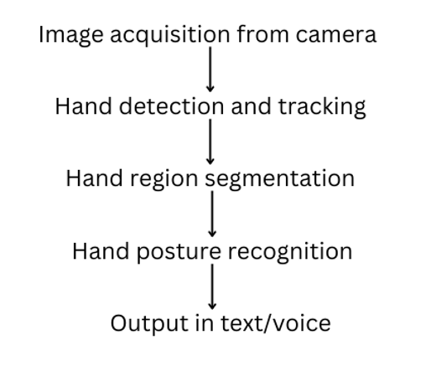
System Workflow

Slide 4
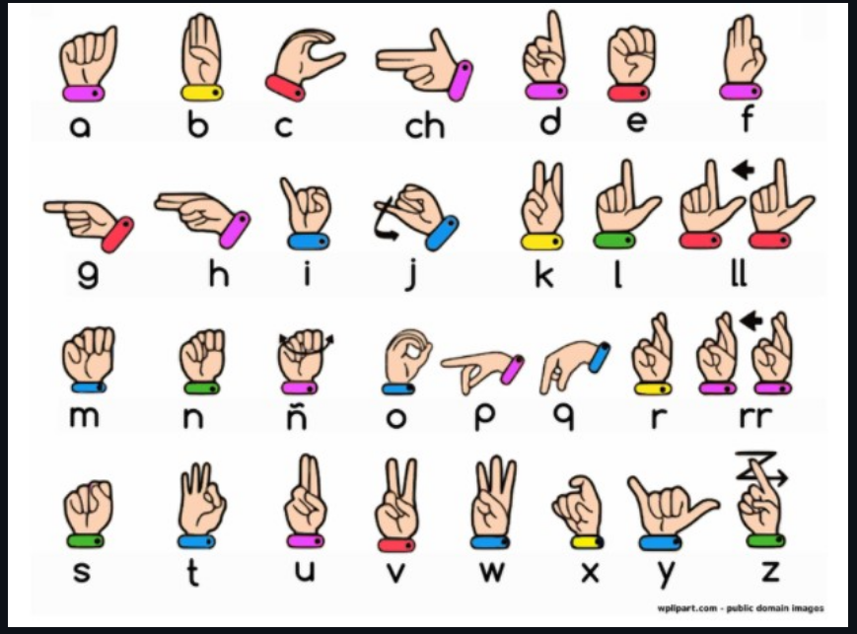

Slide 5
Process: 1. Dataset Collection and Preprocessing: • We collected the dataset of hand gestures and preprocessed the dataset which involved resizing, normalizing, and splitting the data into training, validation and testing sets. 2. Training: • We trained a Convolutional Neural Network (CNN) model on the preprocessed dataset to recognize hand gestures. • During training, we used various techniques such as data augmentation and optimization algorithms to improve the model's performance. 3. Model Evaluation and Tuning: • After training the model, we evaluated its performance using the validation set. • Hyperparameters were tuned to improve accuracy, and performance metrics (like accuracy, precision, recall) were calculated.

Slide 6
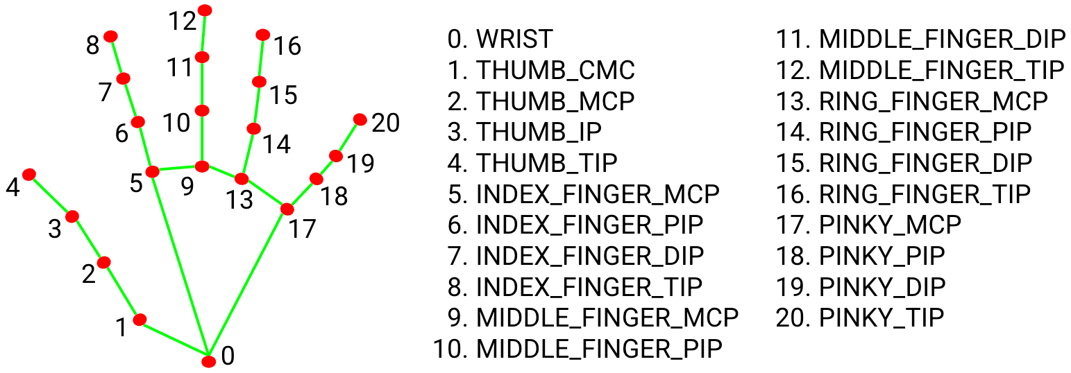
Tech Stack: MediaPipe, OpenCV, and CNN
MediaPipe:
We used MediaPipe for hand detection and tracking. It provides a robust solution for identifying hand landmarks in real-time from video frames.
MediaPipe Hands is a pre-trained model that helps in detecting up to 21 hand landmarks, such as the position of each finger joint, which was crucial for recognizing gestures in the sign language recognition system.
OpenCV:
We used OpenCV for image and video processing in the project.
OpenCV was also essential for visualizing the hand gestures and the predicted sign in the web app interface, ensuring that the user could interact seamlessly with the system.

Slide 7
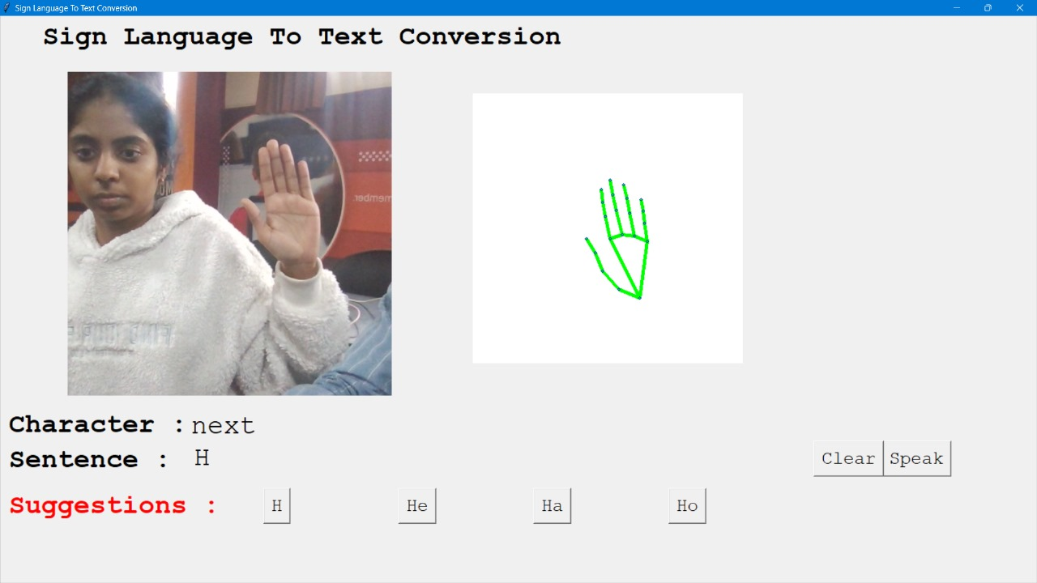
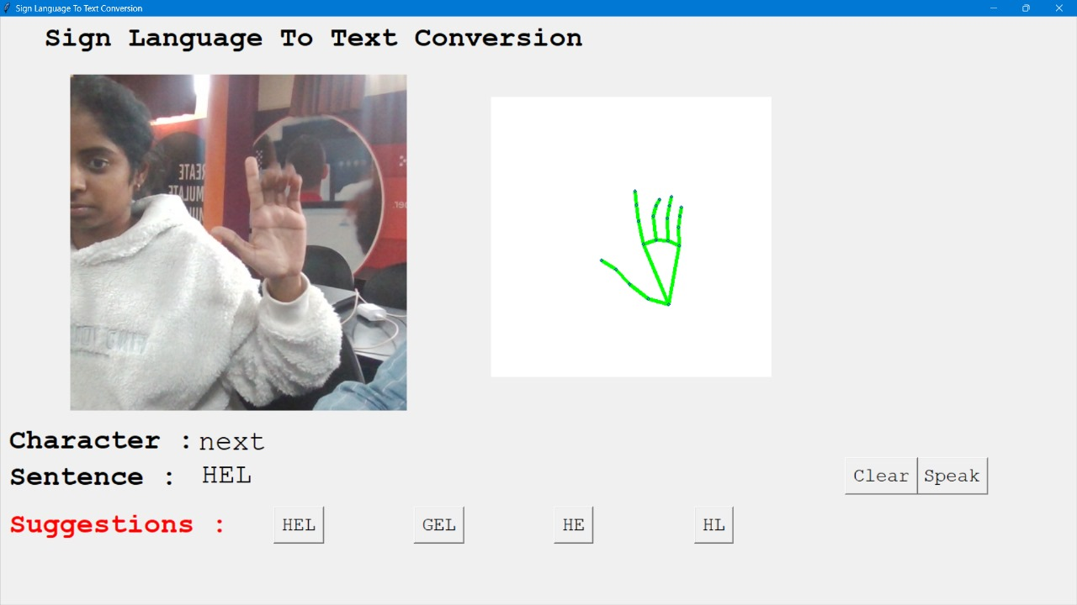

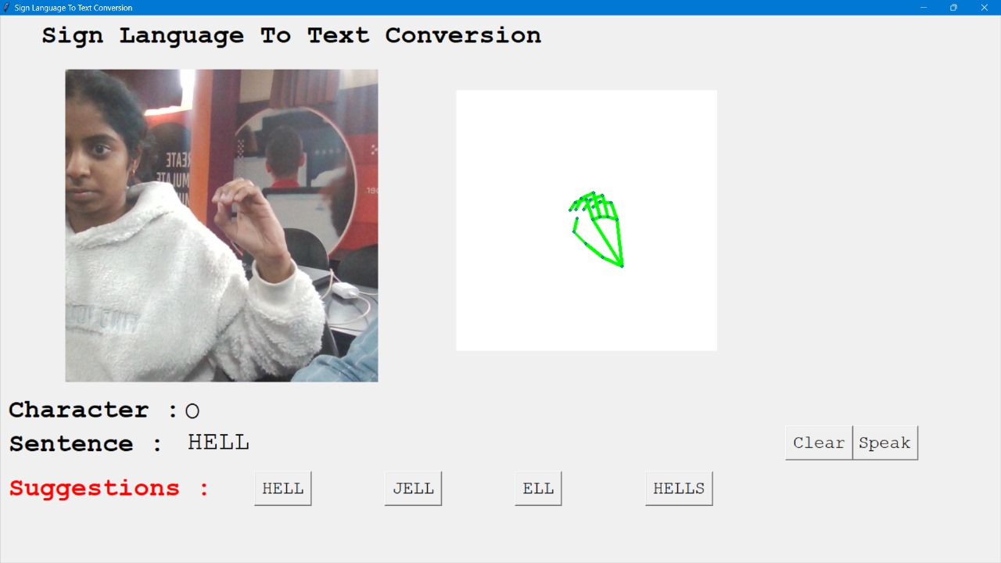
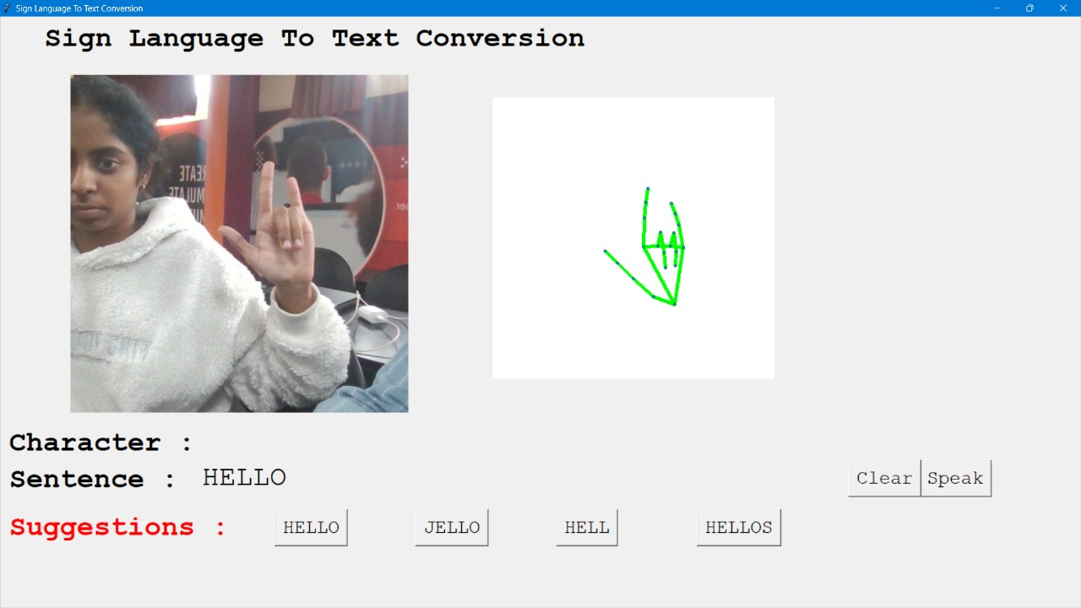

Slide 8
Converting Predicted Gesture to Speech: Text-to-Speech (TTS) Conversion: Use pyttsx3 library for offline speech synthesis. Implementation: Initialize the TTS engine. Convert the predicted letter (e.g., 'A', 'B', etc.) to speech. The engine reads out the predicted letter in real- time.

